Slide 1


UNIVERSITY INSTITUTE OF ENGINEERING AND TECHNOLOGY,
PANJAB UNIVERSITY CHANDIGARH
GLOBAL TERRORISM DASHBOARD
TEAM MEMBERS: TEACHER INCHARGE:
KUHU CHAWLA (UE195069) MS. DALJEET KAUR
MUSKAN GUPTA (UE195078) MS. PREETI GUPTA
PUSHKAR BHARDWAJ (UE195087)
DEPARTMENT OF ELECTRONICS AND COMMUNICATION ENGINEERING

Slide 2
OUTLINE
TITLE
DISTRIBUTION OF PROJECT WORK
INTRODUCTION
NEED AND MOTIVATION FOR A CRITICAL GLOBAL TERRORISM ANALYSIS
BLOCK DIAGRAM OF PROJECT
TOOLS/TECHNOLOGIES USED
METHODOLOGY
SCREENSHOTS OF THE PROJECT AT VARIOUS STAGES
CONCLUSION
FUTURE SCOPE
REFERENCES

Slide 3

Global Terrorism Dashboard
Using
A critical and detailed analysis of the global terrorism over the past half century with statistical reports to help world leaders take informed decisions to curb terrorism

Slide 4
Distribution of Project Work
Kuhu Chawla (UE195069)
Data Gathering and validation.
Exploratory Analysis using Python on Jupyter Notebook.
Data Visualisation on the Tableau Dashboard.
Trend Analysis and Interpretation.
Muskan Gupta (UE195078)
Data cleaning and wrangling using Excel.
Designing of the Tableau Dashboard.
Data Visualisation on the Tableau Dashboard.
Designing and Implementation of the final Tableau storyboard.
Pushkar Bhardwaj (UE195087)
Data cleaning and wrangling using Python.
Exploratory Analytics of the dataset on Jupyter notebook using python.
Technical reporting and documentation.

Slide 5
Introduction
Terrorism is a major problem to the global society. Be it killing of people, or economic impact, or threatening the social well-being of citizens, one terror attack can rupture the lives of many innocent people.
Over the past fifty odd years, terrorism has shown various shades all over the globe. And with a data of so many years, various patterns and trends can be observed. Which, when decoded, can help the security forces to deploy its manpower at the right places and tactically and strategically avert many of such planned mishaps.
In this project, we intend to give a detailed and critical analysis of global terrorism from year 1970 to 2017 with statistical reports to help world leaders take informed decisions to curb terrorism.

Slide 6
Need and motivation for the project
Losing a loved one in an unforeseen terror attack can bring the entire family in a depression which is impossible to overcome.
Even a single terror attack can directly impact the well-being of the citizens of a country, resulting in a slowdown of the economy which, in turn, affects the entire country and also other nations.
There is no doubt that terror attacks take a toll on the global economy acting as an inhibiter to the acceleration of the development which, humans are racing for.
It is thus, necessary for the security forces to decode the pattern of attacks by various terror groups in different parts of the world.
This project, works along the same lines and is thus instrumental for the betterment of the global community.

Slide 7
Block diagram of the project
“Meaningful results can be expected only if you have the right mindset and the right approach to the task”
As any ambitious project is incomplete without a planned work-approach and work distribution among the team, this one was no exception.
// In order to successfully achieve the desired output we had to search through a lot of things and finally made and executed the following
Collection of data from a trusted source
Cleaning of data to remove any null spaces
Using Tableau to analyse the data
Generating the Dashboard and giving deployable insights

Slide 8

Tool used
Dataset collection → Kaggle
Dataset cleaning → Jupyter notebook
Dashboard creation → Tableau

Slide 9
Methodology
Dataset retrieved from Kaggle
cleaning up of dataset and general EDA analysis using python
Cleaned-up dataset uploaded to tableau
Worksheets and dashboards built
Final analysis

Slide 10
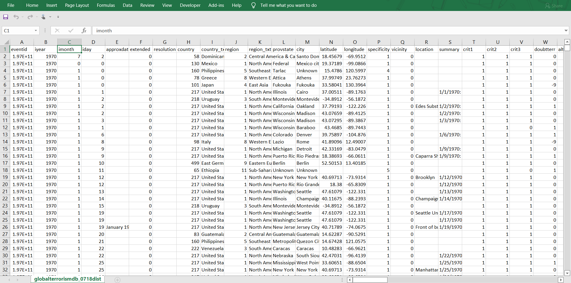
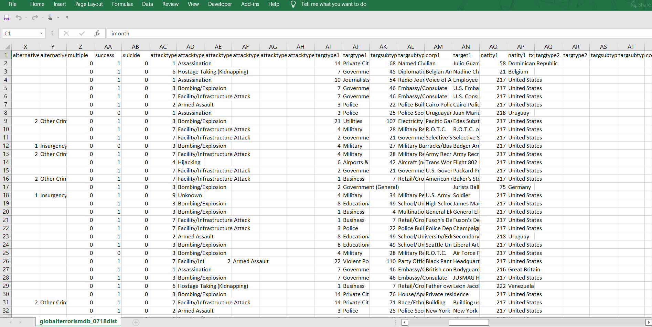
Dataset from Kaggle
Original dataset https://www.start.umd.edu/gtd/

Slide 11
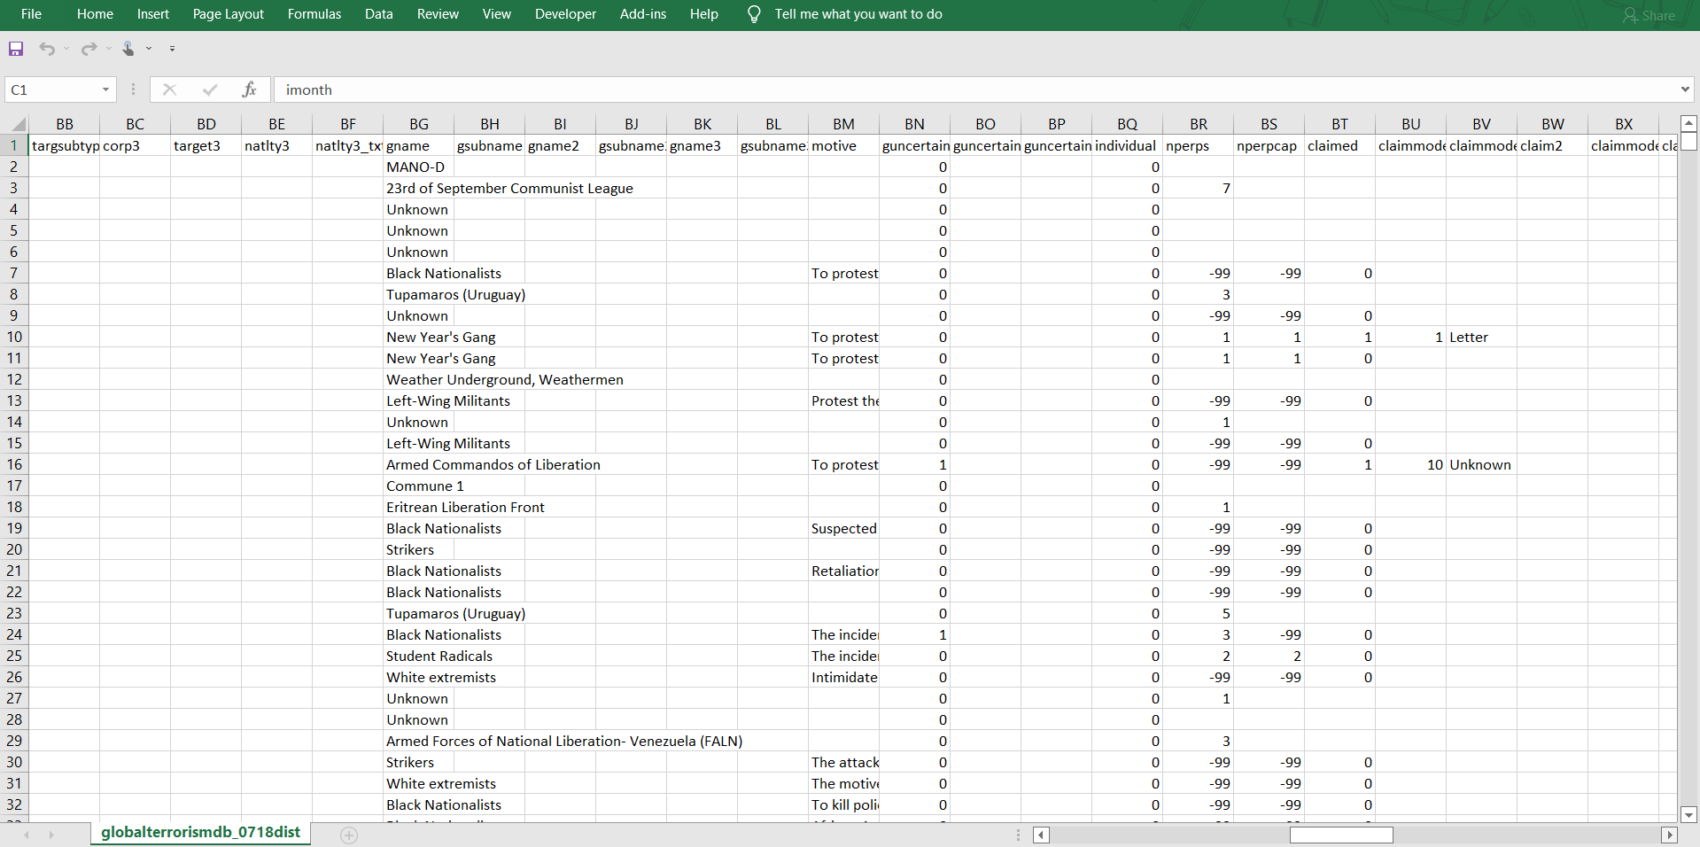
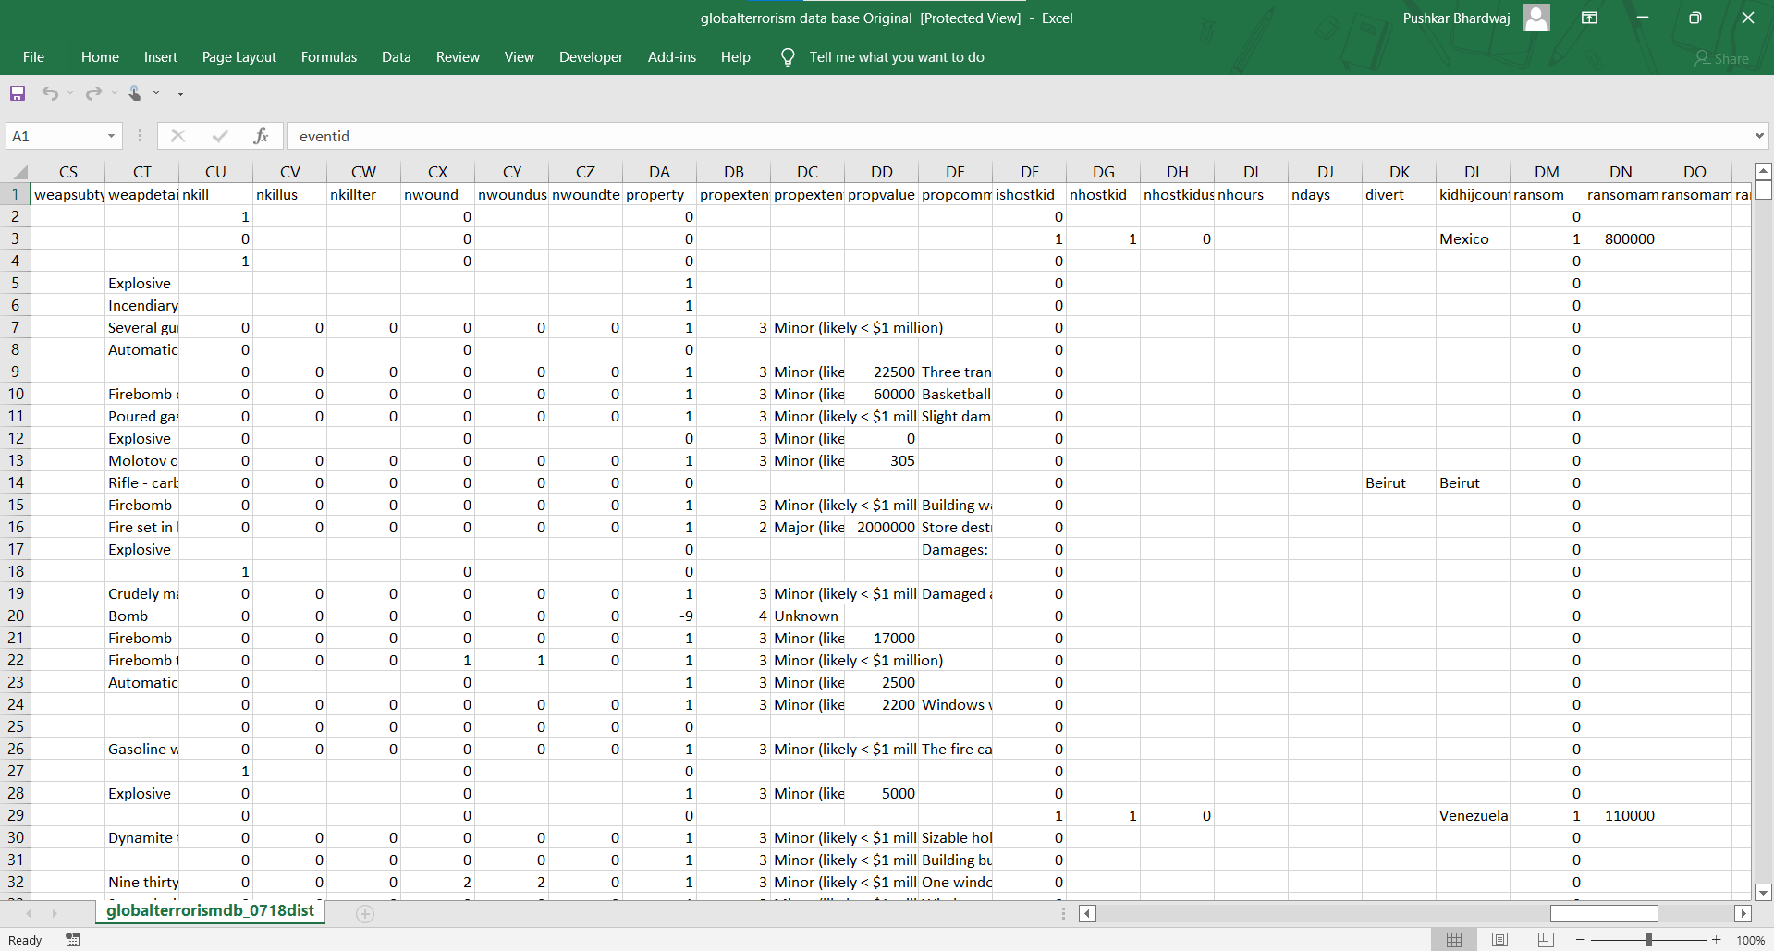
And many more unnecessary columns…

Slide 12
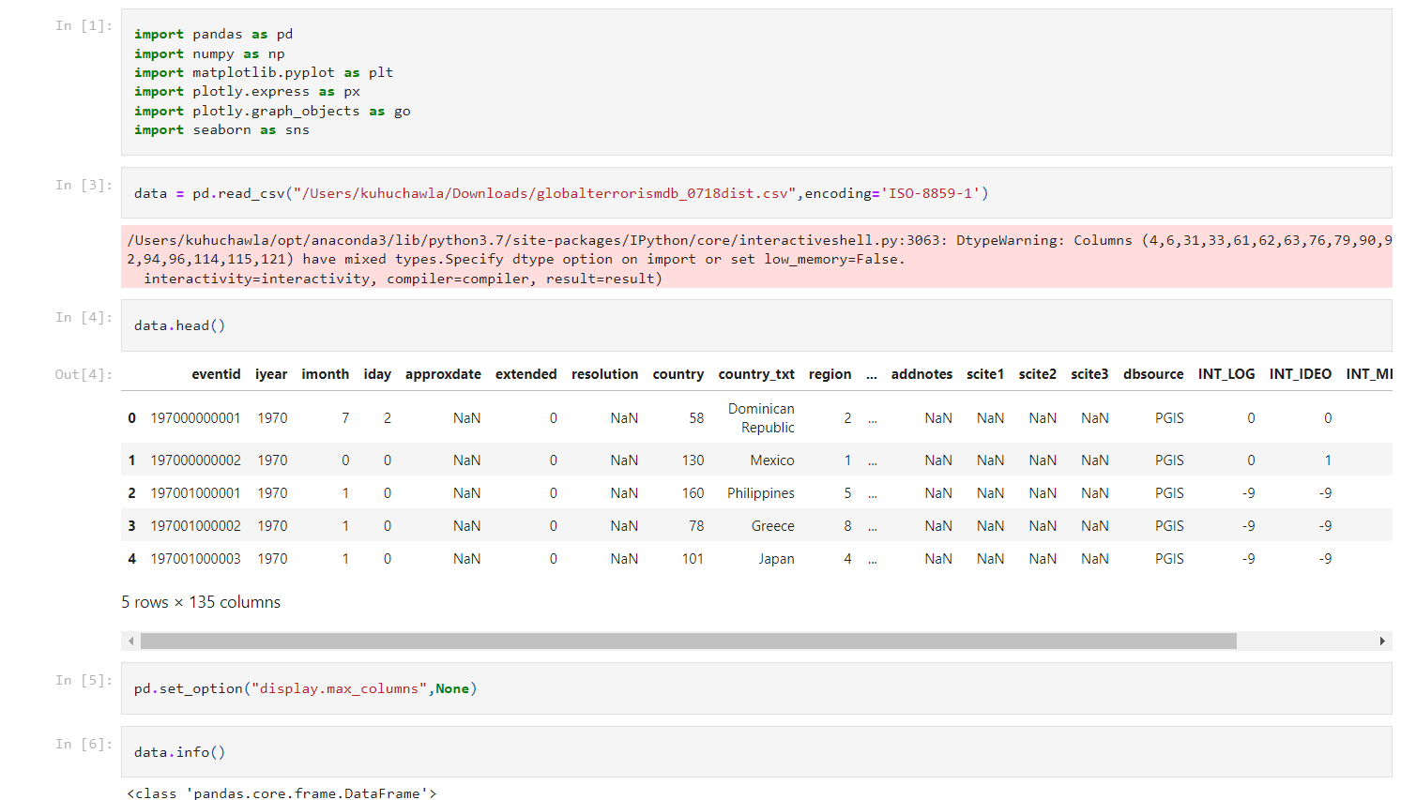
With the initial dataset being a little too extrapolated, having quite large number of null spaces and oddly named columns, it was imperative to clean it before putting it to use.
We wrote some python scripts and were able to make the data more readable and reliable than before.
We renamed the columns and filtered out the important data from the whole data set.
Technically, the process is called “cleaning” the data.

Slide 13
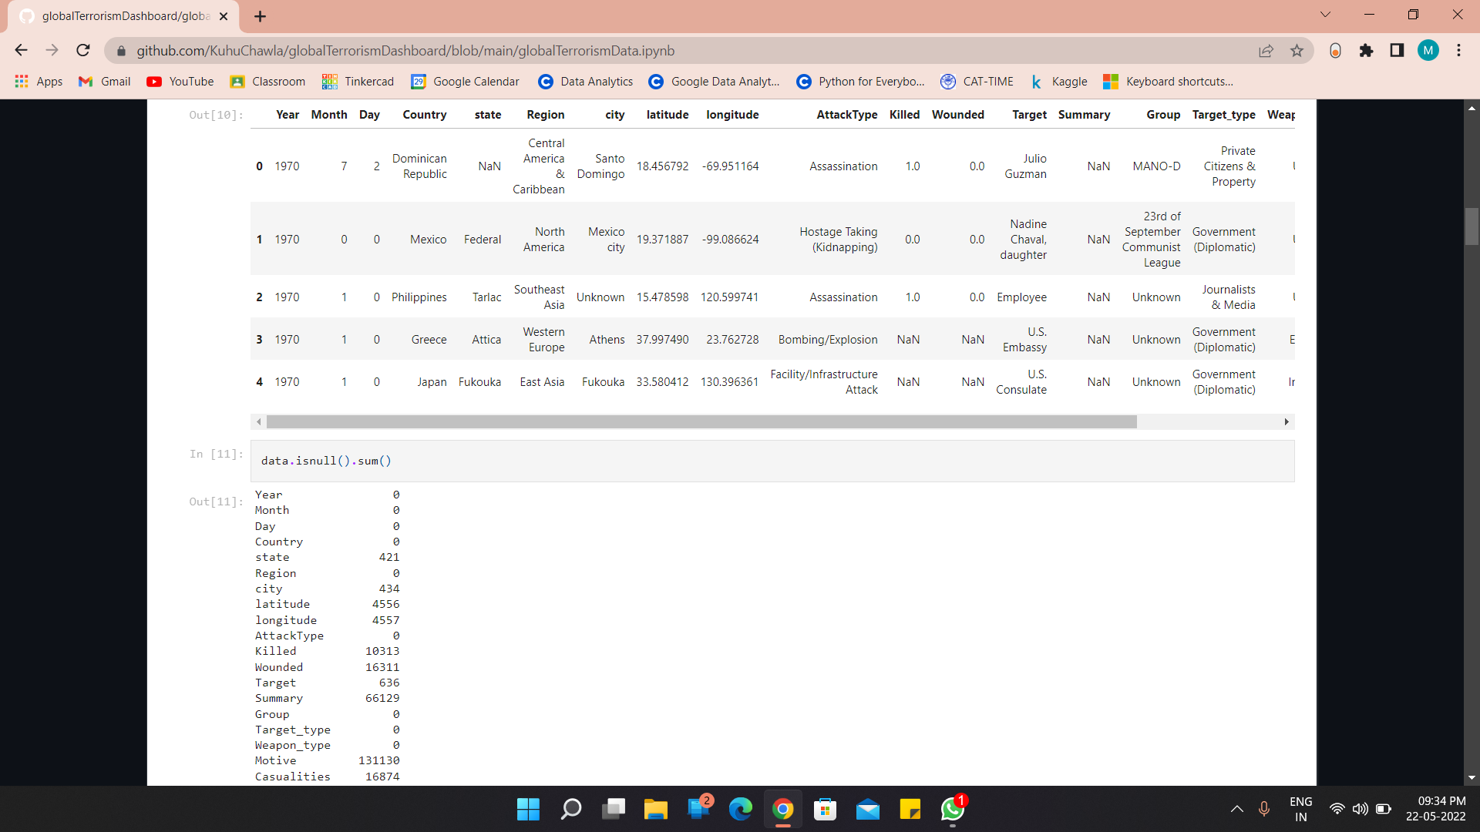
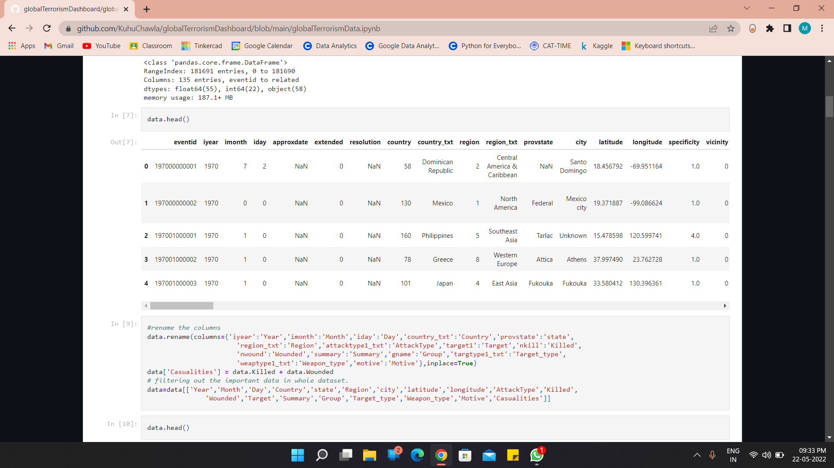

Slide 14

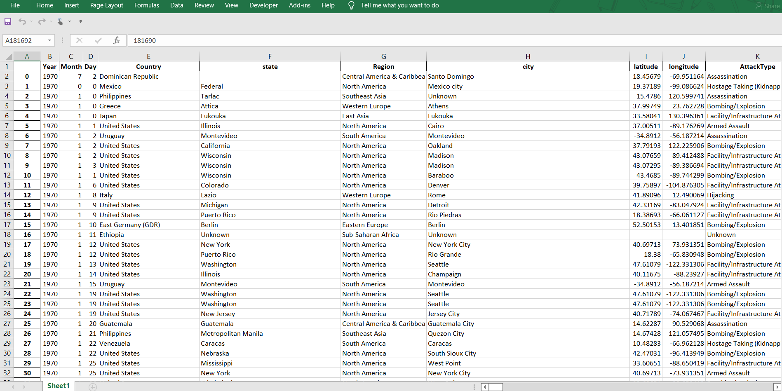
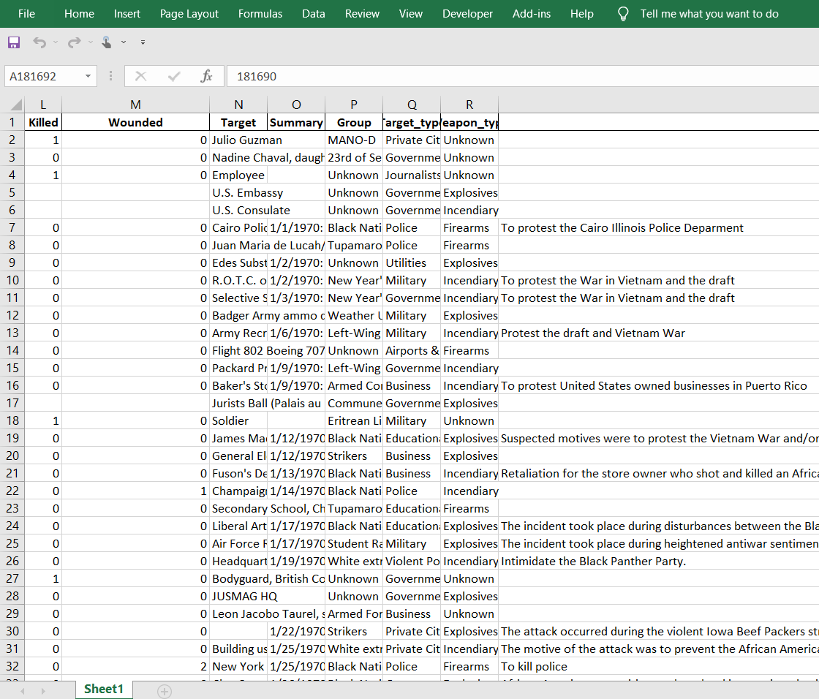

- Cleaned Dataset
This dataset is, obviously, more clean readable

Slide 15
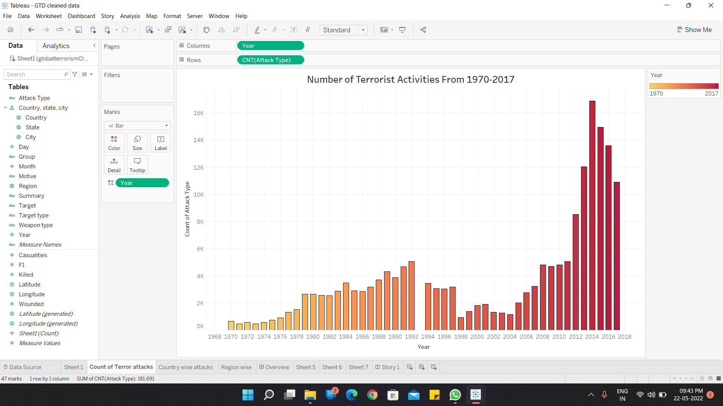
Screenshots at various stages of the project
1. Year-wise depiction f the number of terror attacks as a bar graph

Slide 16
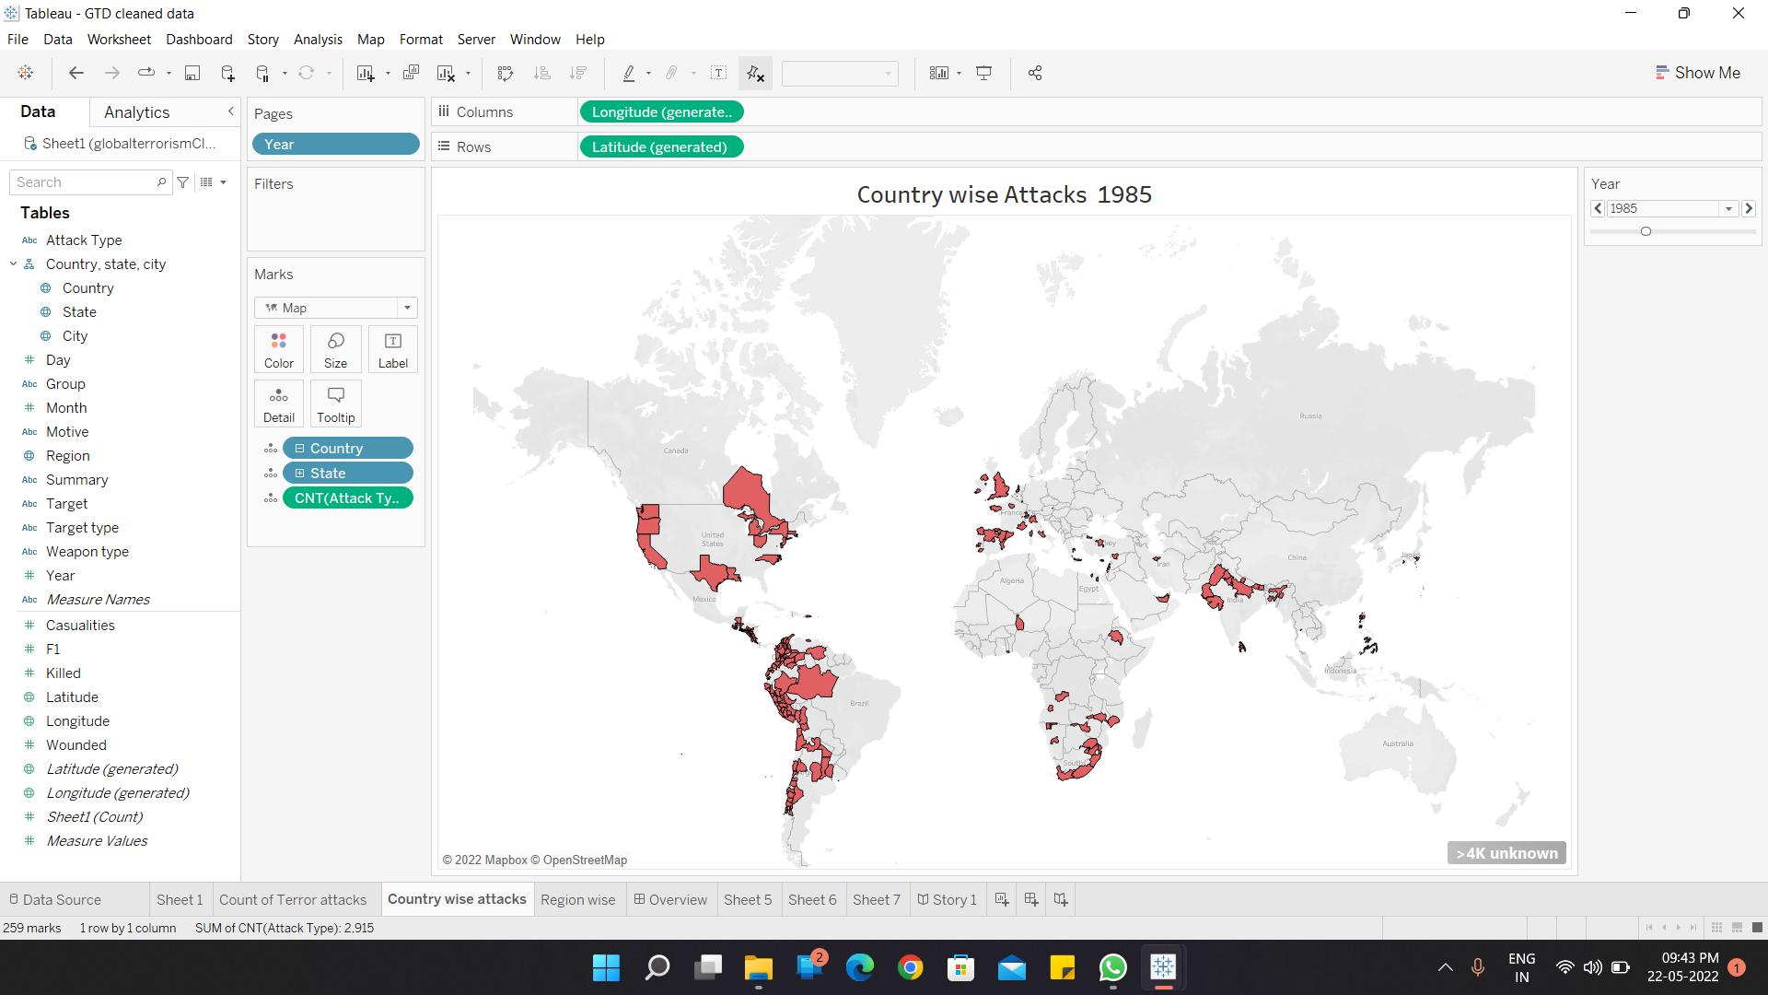
2. Country-wise Attacks (year 1985)

Slide 17
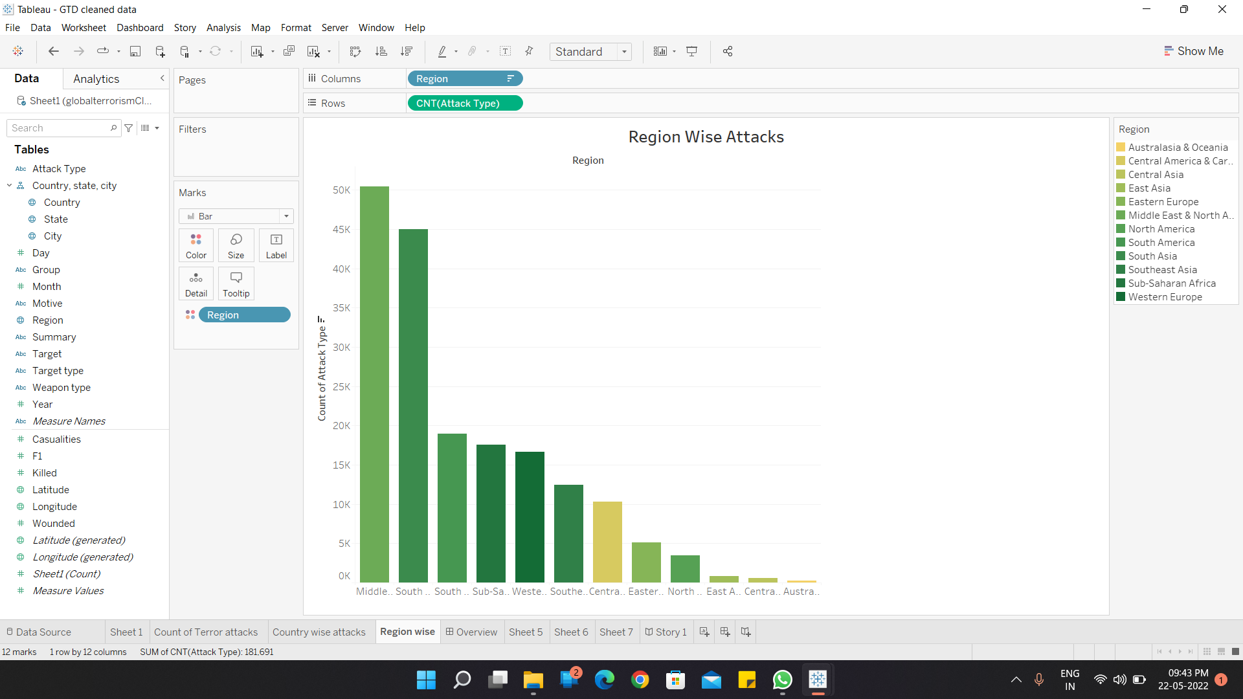
3. Region wise depiction

Slide 18
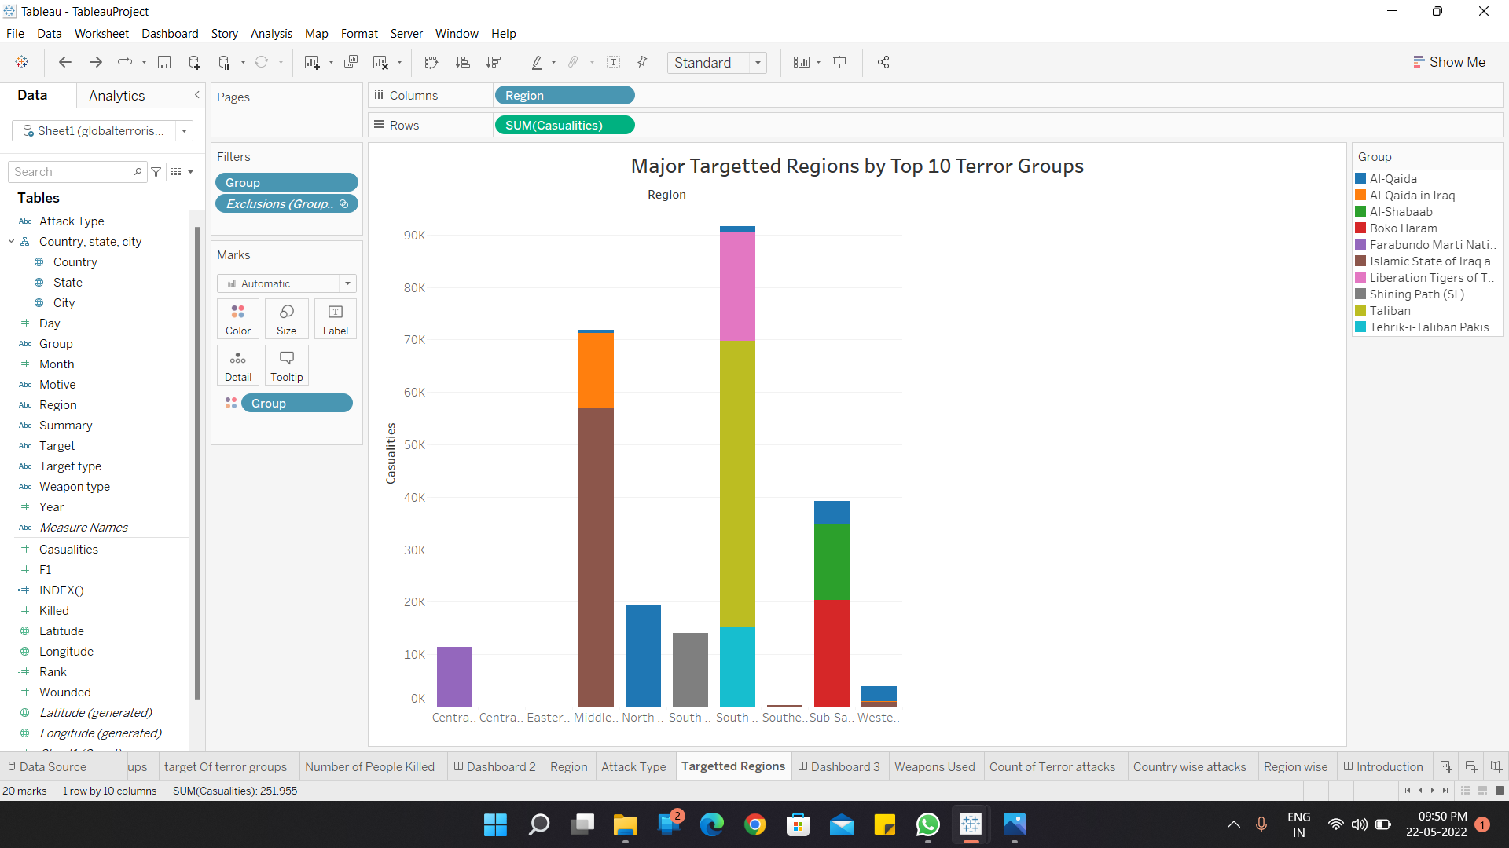
4. Major targeted regions by top 10 terror groups

Slide 19
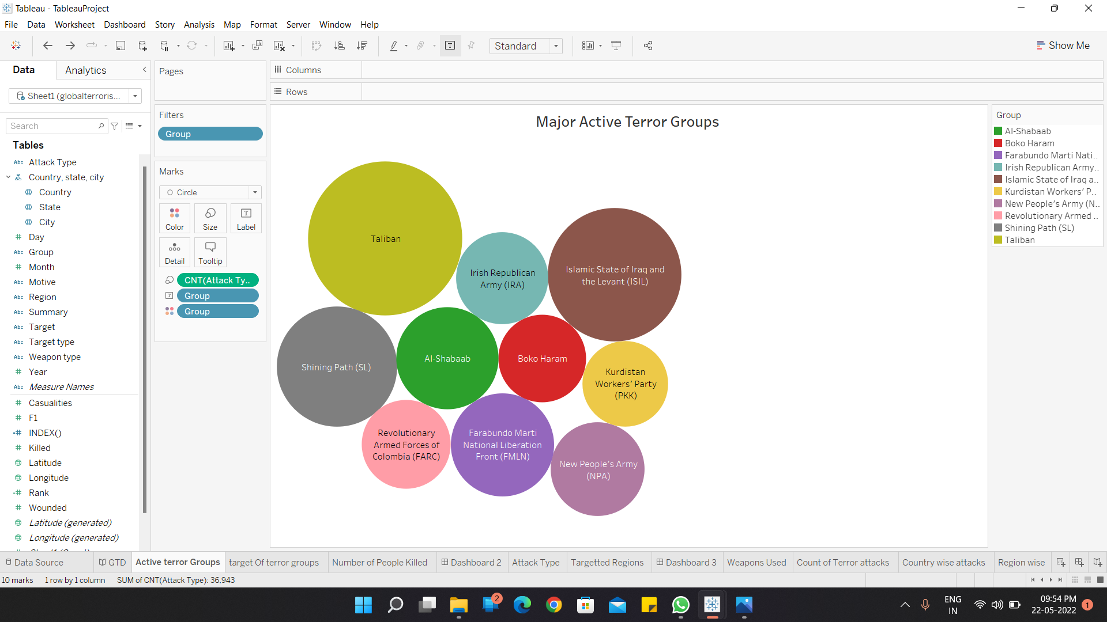
5. Major active Terror groups

Slide 20
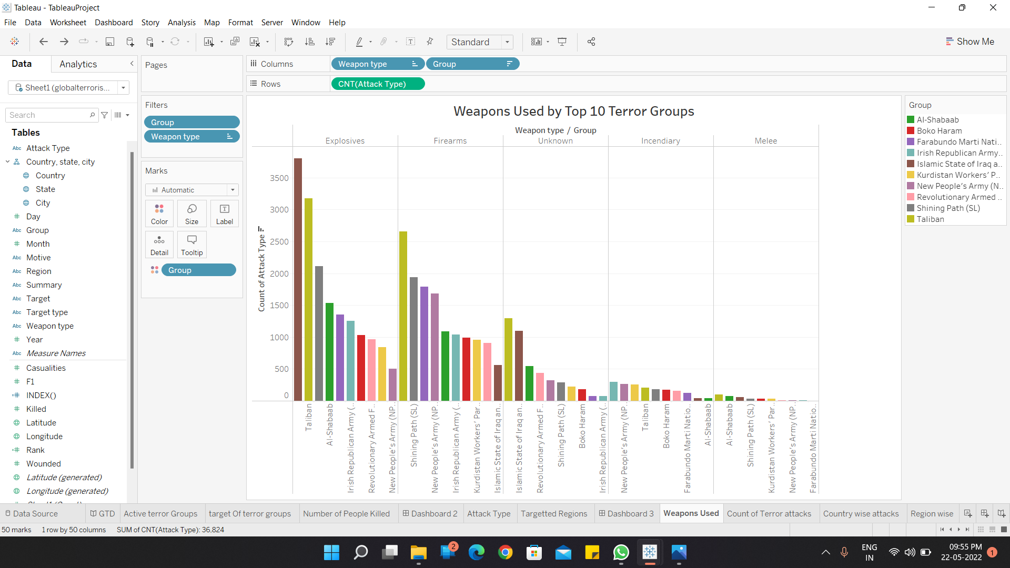
6. Weapons used

Slide 21
Conclusion
It can be seen that in year 2011 terror attacks had spiked-up and reached its crescendo around 2014-15, killing and devastating many individuals.
From the Dashboard we are able to analyse which regions should focus on which terror groups.
We are also able to give an output of which weapon trade the specific region should focus
Regions of North Africa and the middle east. Syria, Iran, Lebanon, Labia and Nigeria being the worst affected. And terror groups such as ISIS and ISIL being the most active.

Slide 22
While the sub-Saharan and the middle east was enwrapped by the ISIL and ISIS, The region of South Asia has resulted in the most number of attacks, by number, with Afghanistan being the epicentre and Taliban being the top conspirator.
Thick population being a favourable condition for the terror attacks, the south Asian regions of Afghanistan, Pakistan and India are susceptible but with the help of an analysis such as the one we have done vigilant security forces working day in and day out, and the intelligence bureau, the attacks have reduced in the past years.

Slide 23
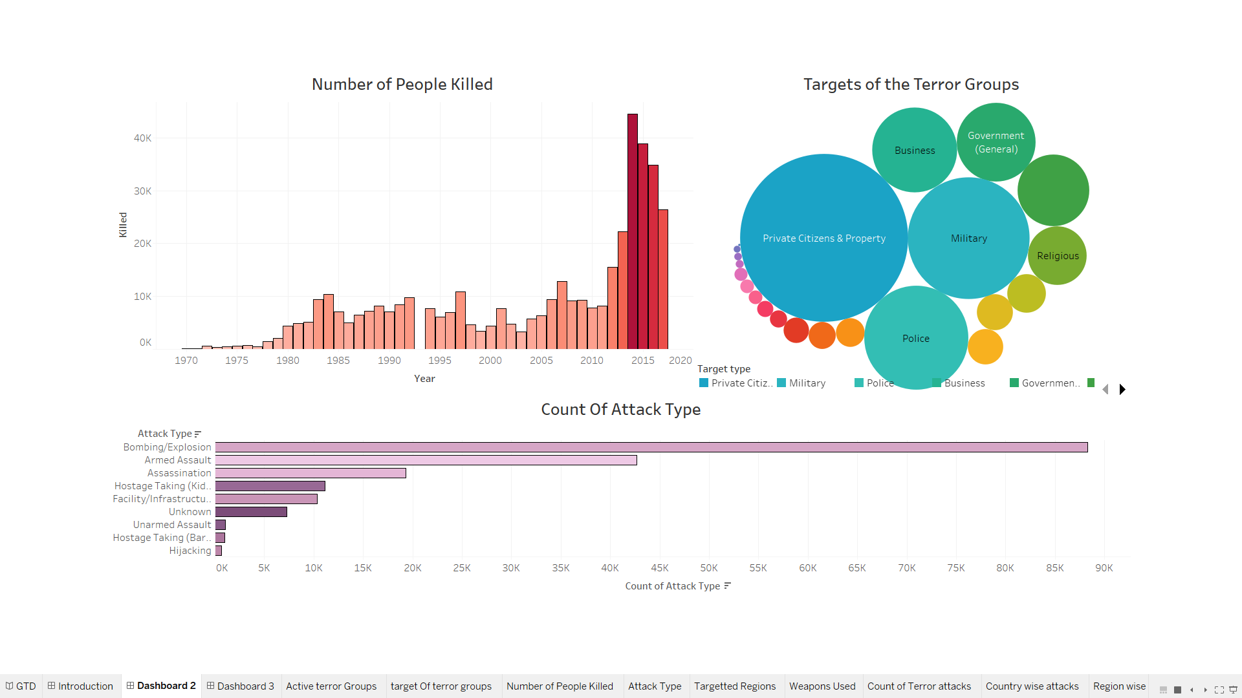
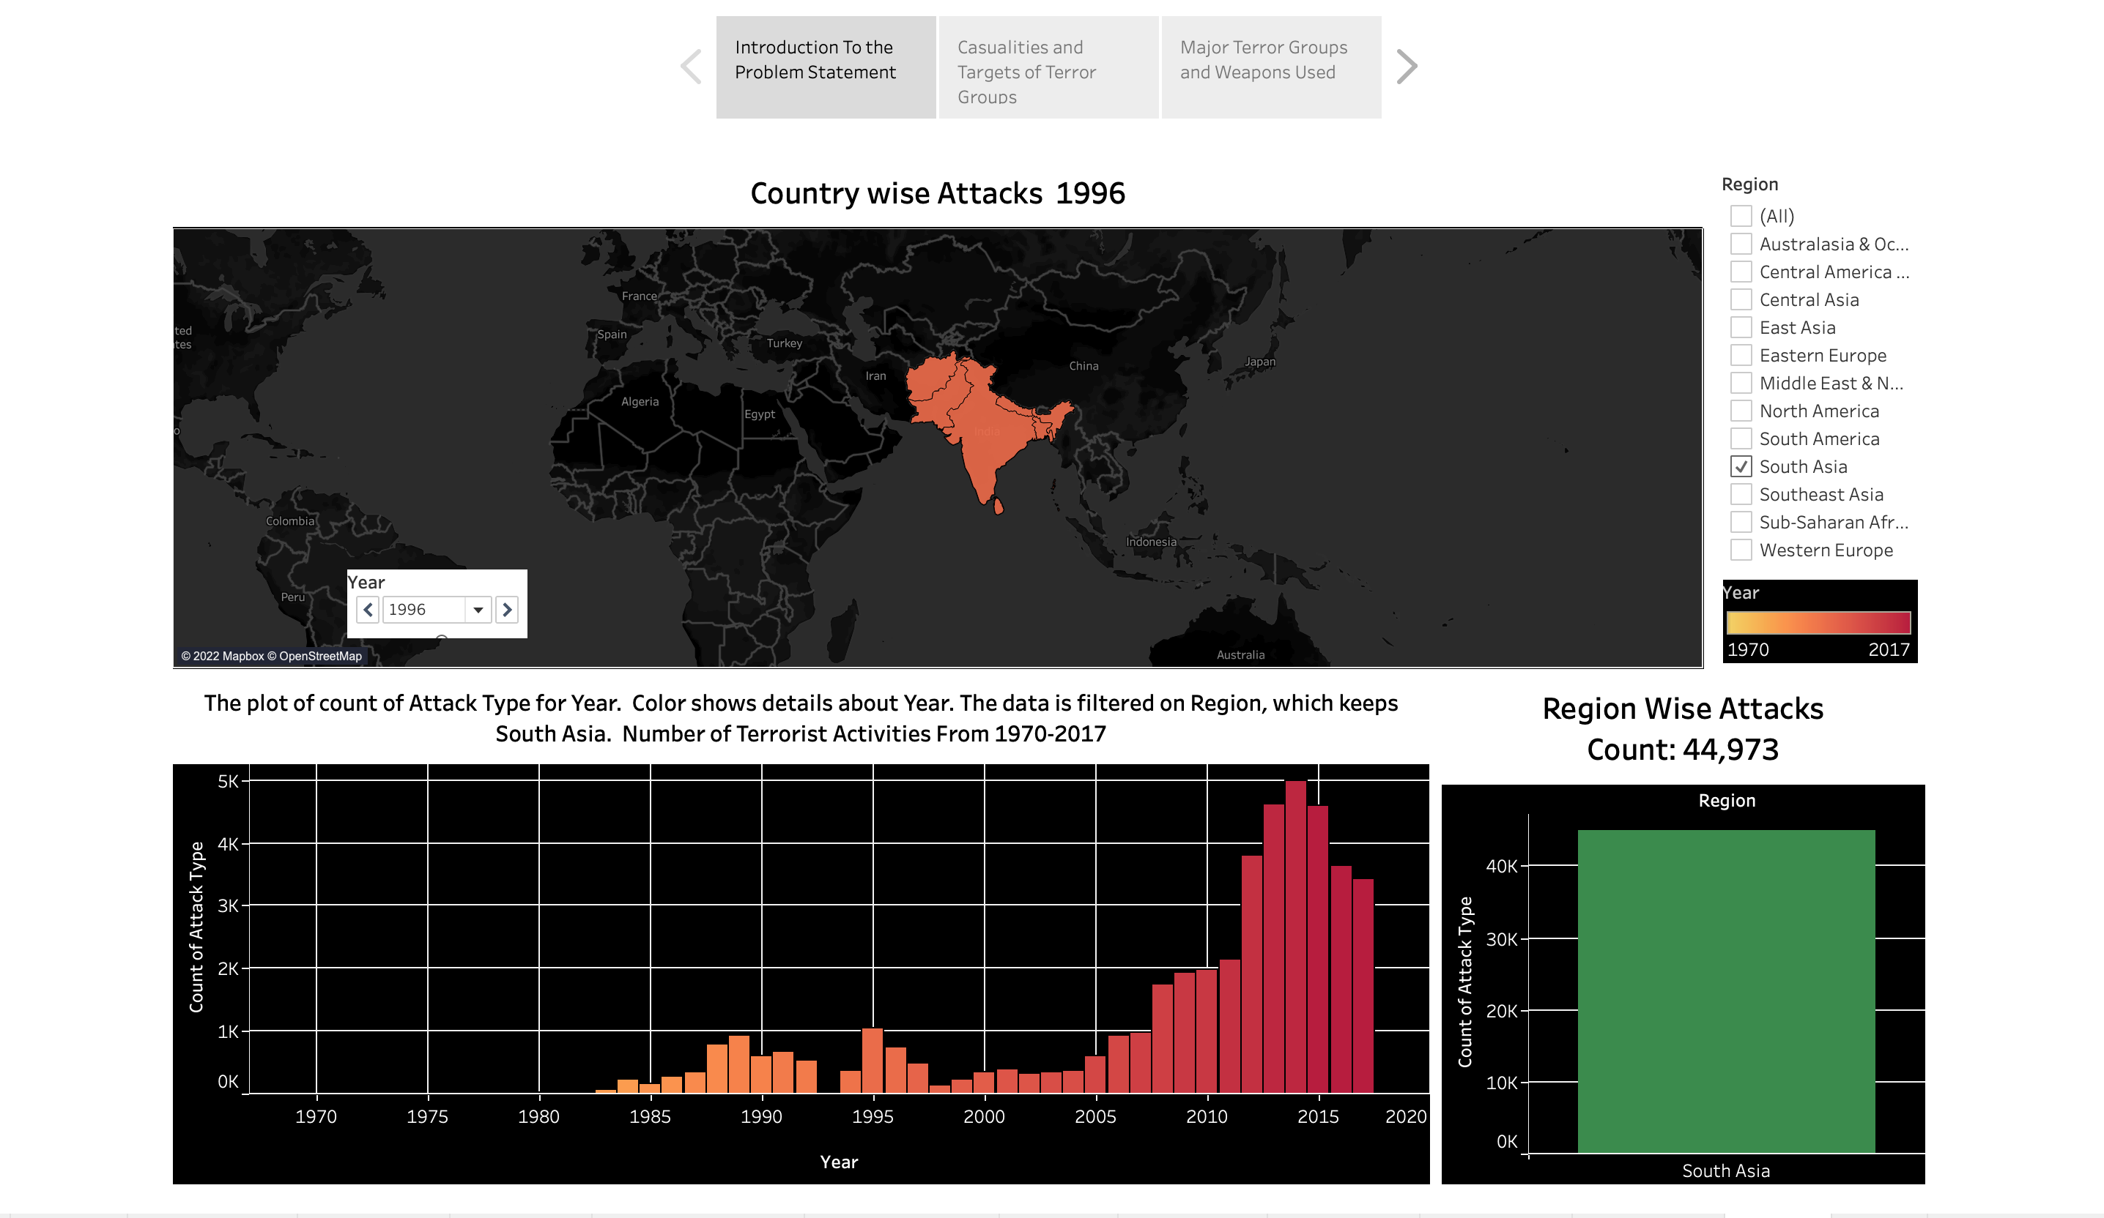
REGION: SOUTH ASIA

Slide 24
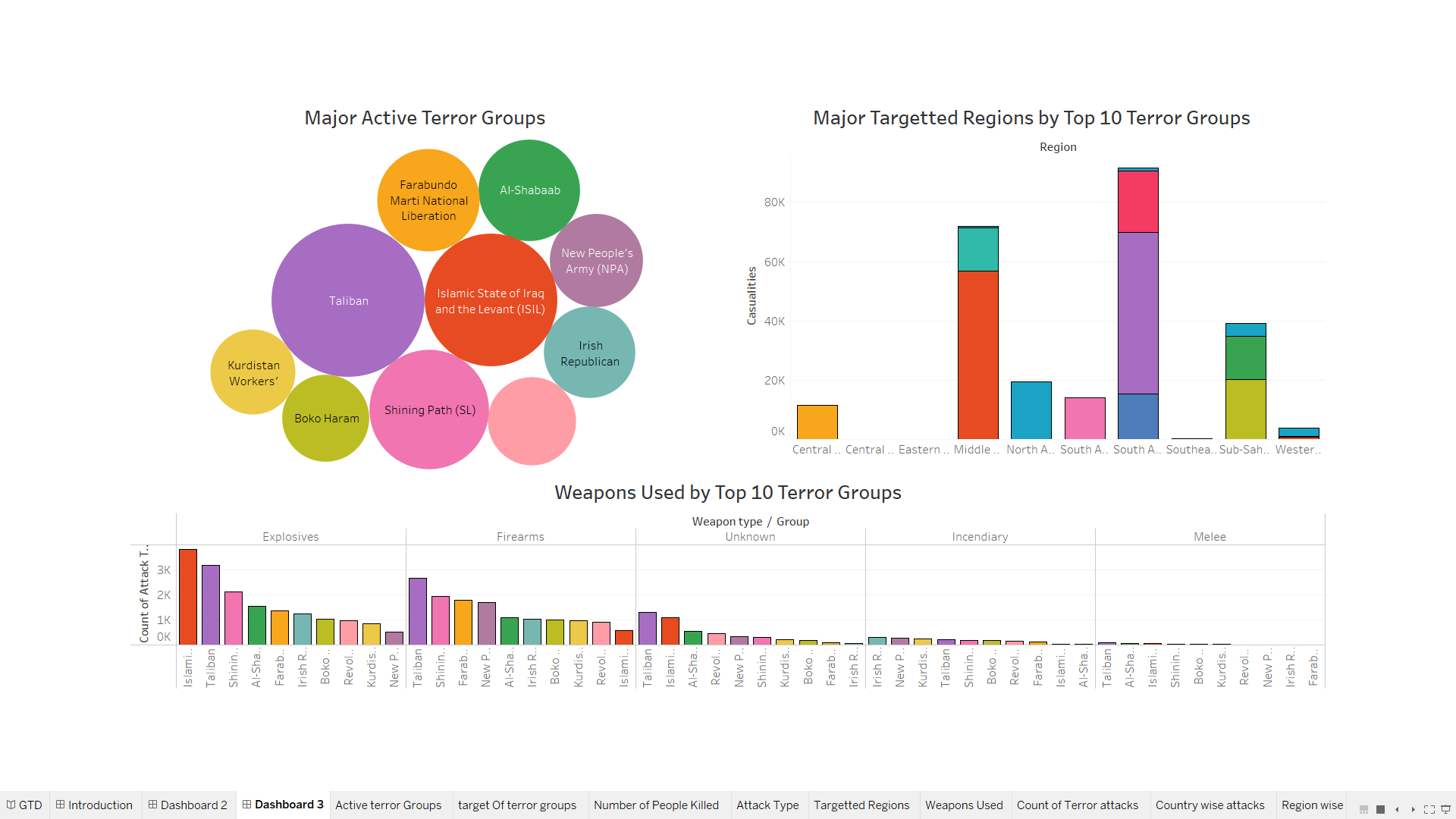
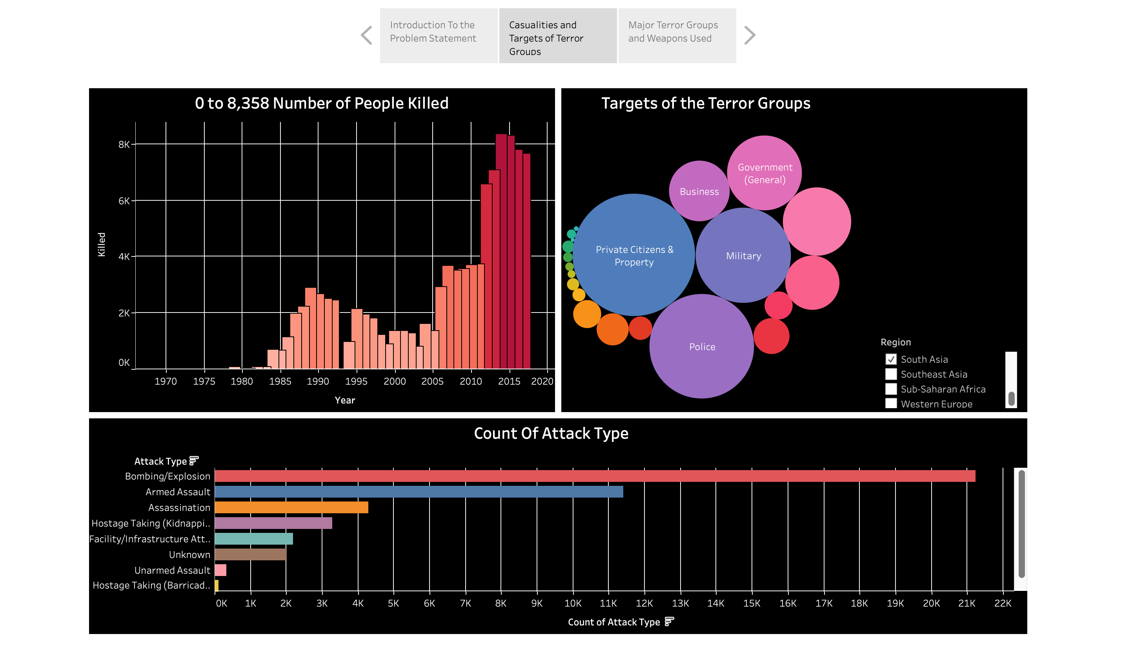
REGION: SOUTH ASIA

Slide 25
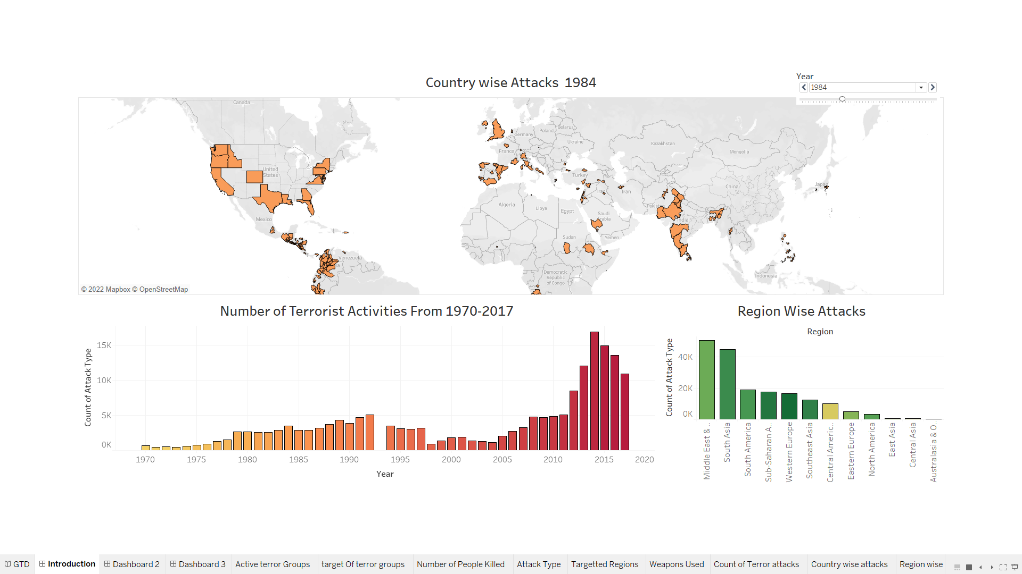
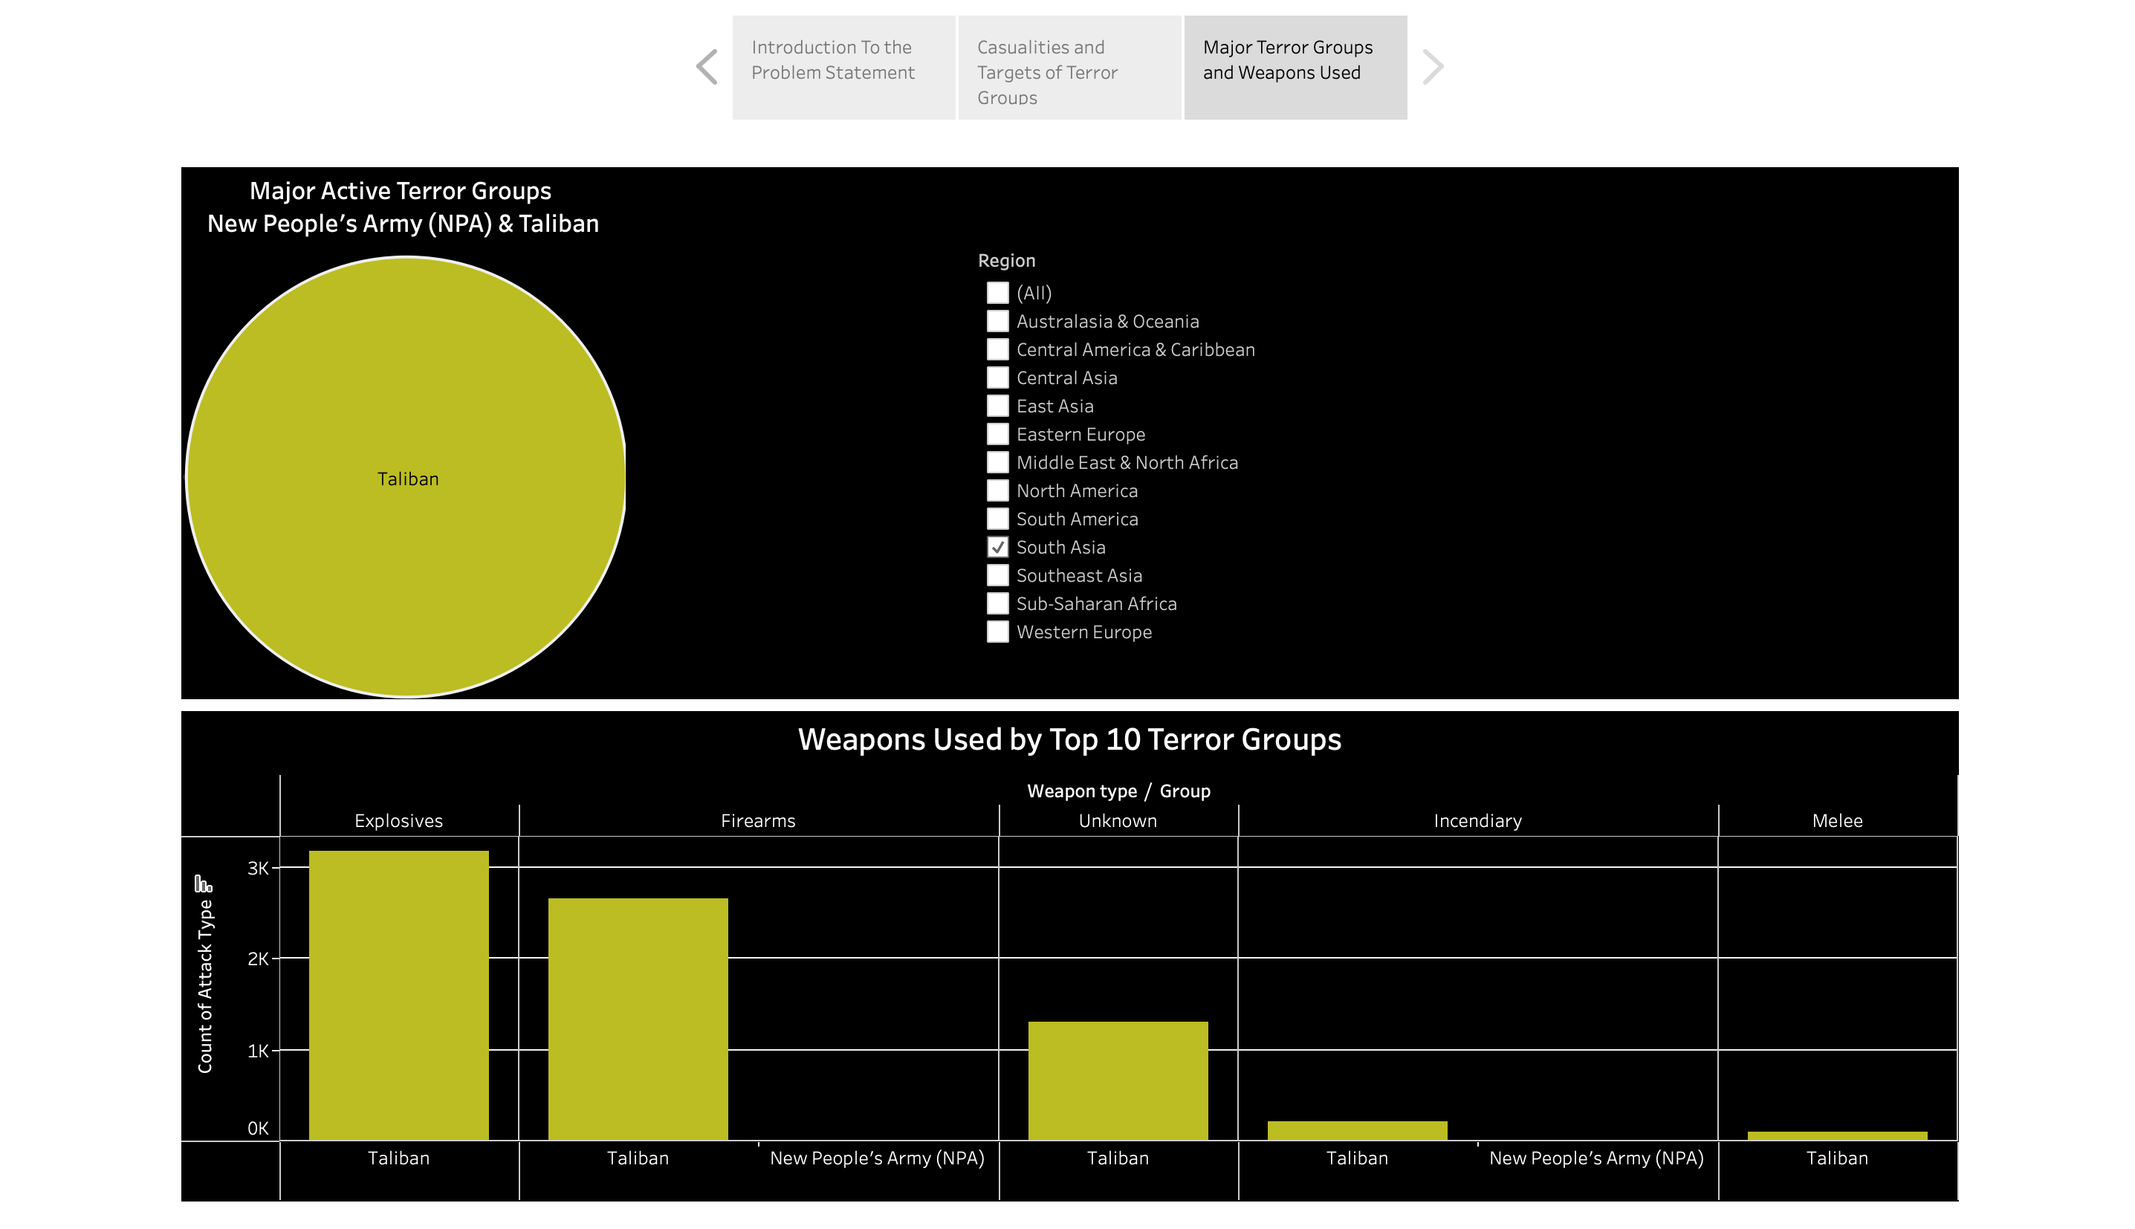
REGION: SOUTH ASIA

Slide 26
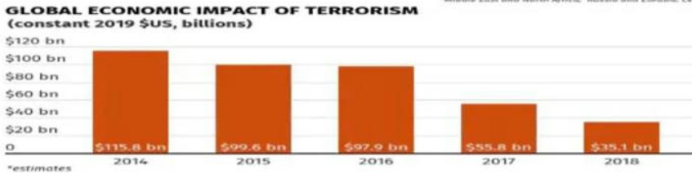

Future scope
A good analysis can be done with a large data set, so this GTD shall be instrumental in curbing terror attacks for a long time and regular updates will make it rather more reliable, reducing the impact of terror attacks in the years to come.
Apart from just terrorism analysis, the knowledge and implementation of data analytics can help companies to spruce up their marketing strategies by keeping a watch on what people like.

Slide 27
References
The data of the terrorism dataset collected from Kaggle is maintained by University of Maryland, United States.
Link: https://www.start.umd.edu/gtd/
GeeksForGeeks: https://www.geeksforgeeks.org/introduction-to-tableau/
Research Papers: https://www.tandfonline.com/doi/full/10.1080/09546550701246817https://www.ncbi.nlm.nih.gov/pmc/articles/PMC5462416/

Slide 28

Thank You !

